Slide 1
Multicore Applications Team
KeyStone C66x Multicore
SoC Overview
Notes:
1
NEW

Slide 2
Enhanced DSP core
100% upward object code compatible
4x performance improvement for multiply operation
32 16-bit MACs
Improved support for complex arithmetic and matrix computation
C66x ISA
Performance Improvement
100% upward object code compatible with C64x, C64x+, C67x and c67x+
Best of fixed-point and floating-point architecture for better system performance and faster time-to-market
C674x
C64x+
2x registers
Enhanced floating-point add capabilities
SPLOOP and 16-bit instructions for smaller code size
Flexible level one memory architecture
iDMA for rapid data transfers between local memories
C67x+
C64x
Native instructions for IEEE 754, SP&DP
Advanced VLIW architecture
Advanced fixed-point instructions
Four 16-bit or eight 8-bit MACs
Two-level cache
C67x
FLOATING-POINT VALUE
FIXED-POINT VALUE
Notes:
2

Slide 3
KeyStone Device Architecture
Memory Subsystem
Application-Specific
CorePac
64-Bit
MSM
Coprocessors
Memory Subsystem
DDR3 EMIF
SRAM
MSMC
Multicore Navigator
Debug & Trace
Network Coprocessor
Boot ROM
External Interfaces
Semaphore
C66x™
TeraNet Switch Fabric
Power
CorePac
Diagnostic Enhancements
Management
PLL
L1P
L1D
HyperLink Bus
x3
Cache/RAM
Cache/RAM
Miscellaneous
EDMA
L2 Memory Cache/RAM
x3
1 to 8 Cores @ up to 1.25 GHz
Application-Specific
HyperLink
TeraNet
Multicore Navigator
Queue
Packet
Manager
DMA
x2
x4
t
T
e
h
C
R
I
n
c
e
P
Application
Specific I/O
O
r
t
h
Security
Application
Specific I/O
GPIO
2
I
A
S
e
i
c
I
C
U
I
h
w
t
Accelerator
P
R
t
S
i
S
E
w
S
Packet
I
Accelerator
I
M
x2
G
S
Network Coprocessor
Notes:
3
NEW

Slide 4
C66x CorePac
Memory Subsystem
Application-Specific
CorePac
64-Bit
MSM
Coprocessors
DDR3 EMIF
SRAM
1 to 8 C66x CorePac DSP Cores operating at up to 1.25 GHz
Fixed- and floating-point operations
Code compatible with other C64x+ and C67x+ devices
L1 Memory
Can be partitioned as cache and/or RAM
32KB L1P per core
32KB L1D per core
Error detection for L1P
Memory protection
Dedicated L2 Memory
Can be partitioned as cache and/or RAM
512 KB to 1 MB Local L2 per core
Error detection and correction for all L2 memory
Direct connection to memory subsystem
MSMC
Debug & Trace
Boot ROM
Semaphore
C66x™
Power
CorePac
Management
PLL
L1P
L1D
x3
Cache/RAM
Cache/RAM
EDMA
L2 Memory Cache/RAM
x3
1 to 8 Cores @ up to 1.25 GHz
HyperLink
TeraNet
Multicore Navigator
Queue
Packet
Manager
DMA
x2
x4
t
T
e
h
C
R
I
n
c
e
P
Application
Specific I/O
O
r
t
h
Security
Application
Specific I/O
GPIO
2
I
A
S
e
i
c
I
C
U
I
h
w
t
Accelerator
P
R
t
S
i
S
E
w
S
Packet
I
Accelerator
I
M
x2
G
S
Network Coprocessor
Notes:
4
NEW

Slide 5
C66x CorePac Architecture
C66x CorePac
CorePac includes:
DSP Core
Two registers
Four functional units per register side
L1P memory (Cache/RAM)
L1D memory (Cache/RAM)
L2 memory (Cache/RAM)
Level 1 Program
Memory (L1P)
Single-Cycle
Cache / RAM
Level 2
Memory
(L2)
Program / Data
Cache / RAM
256
DSP Core
Instruction Fetch
M
L
M
L
S
D
S
D
Reg A [32]
Reg B [32]
Memory Controller
64-bit
Level 1 Data
Memory (L1D)
Single-Cycle
Cache / RAM

Slide 6
C66x DSP Core
Memory
Four functional units per side:
Multiplier (.M)
ALU (.L)
Data (.D)
Control (.S)
These independent functional units enable efficient execution of parallel specialized instructions:
Multiplier (.M1and.M2) and ALU (.L1 and .L2) provide MAC (multiple accumulation) operations.
Data (.D) provides data input/output.
Control (.S) provides control functions (loop, branch, call).
Each DSP core dispatches up to eight parallel instructions each cycle.
All instructions are conditional, which enables efficient pipelining.
The optimized C compiler generates efficient target code.
A0
.D1
.D2
B0
.S1
.S2
MACs
.M1
.M2
. .
.L1
.L2
. .
A31
B31
Controller/Decoder

Slide 7
C66x DSP Core Cross-Path
Register File A
Register File B
Any 64-bit pair of registers from A can be one of the inputs to a B functional unit, and vice versa.
A0
B0
A1
B1
A2
B2
A3
B3
A4
B4
. . .
. . .
A
B
.D1
.D1
A31
.S1
.S1
B31
.M1
.M1
.L1
.L1

Slide 8
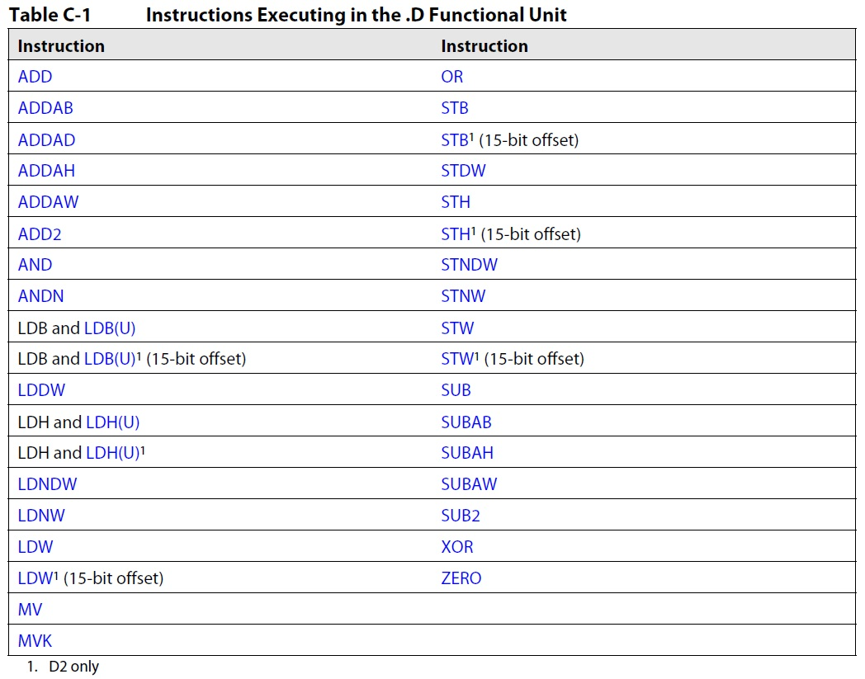
Partial List of .D Instructions

Slide 9
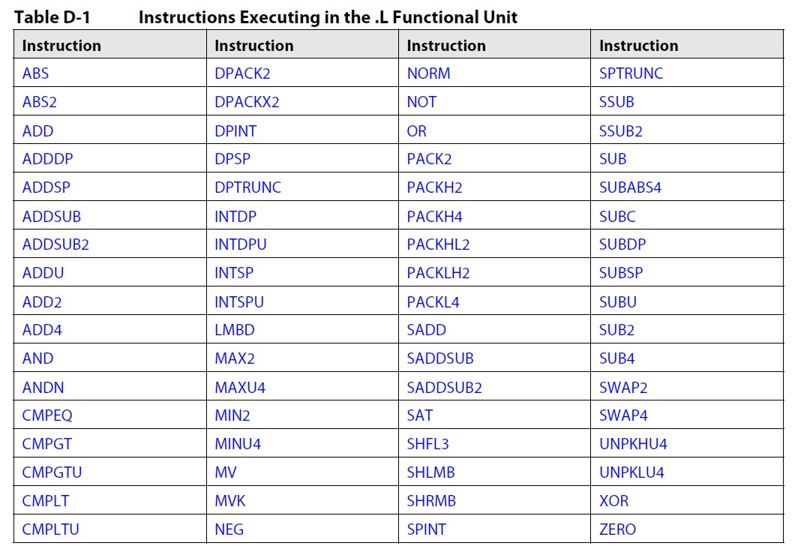
Partial List of .L Instructions

Slide 10
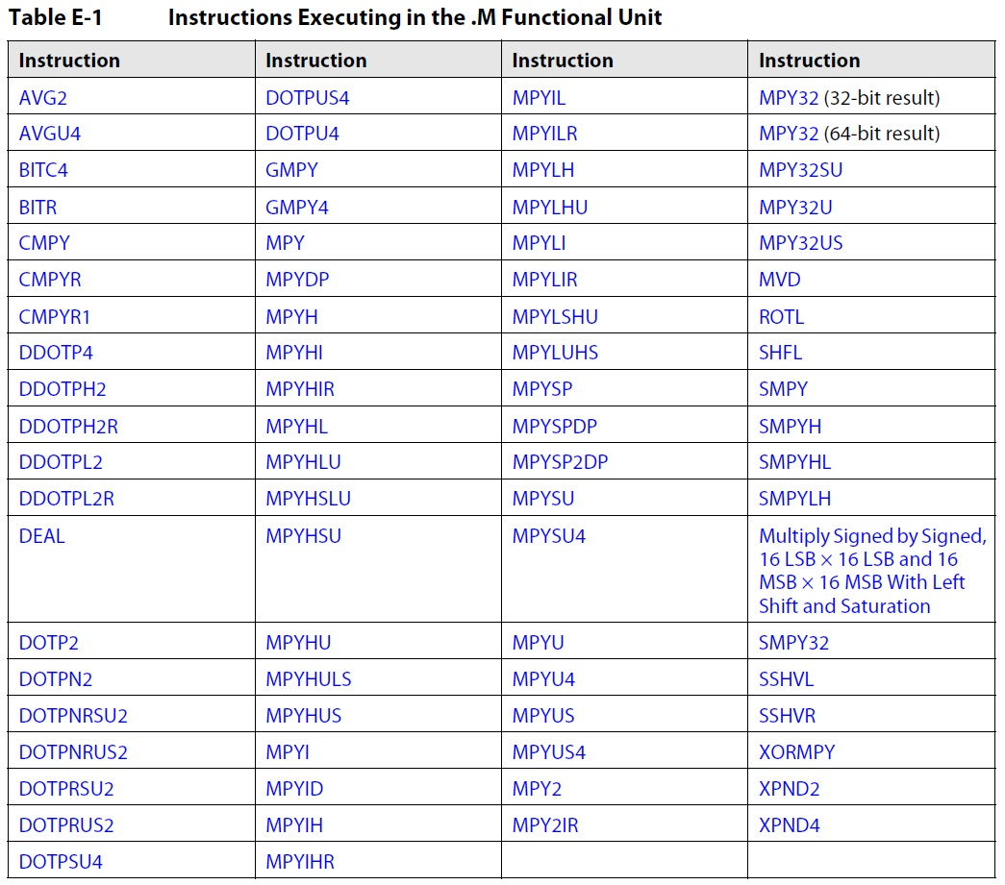
Partial List of .M Instructions

Slide 11
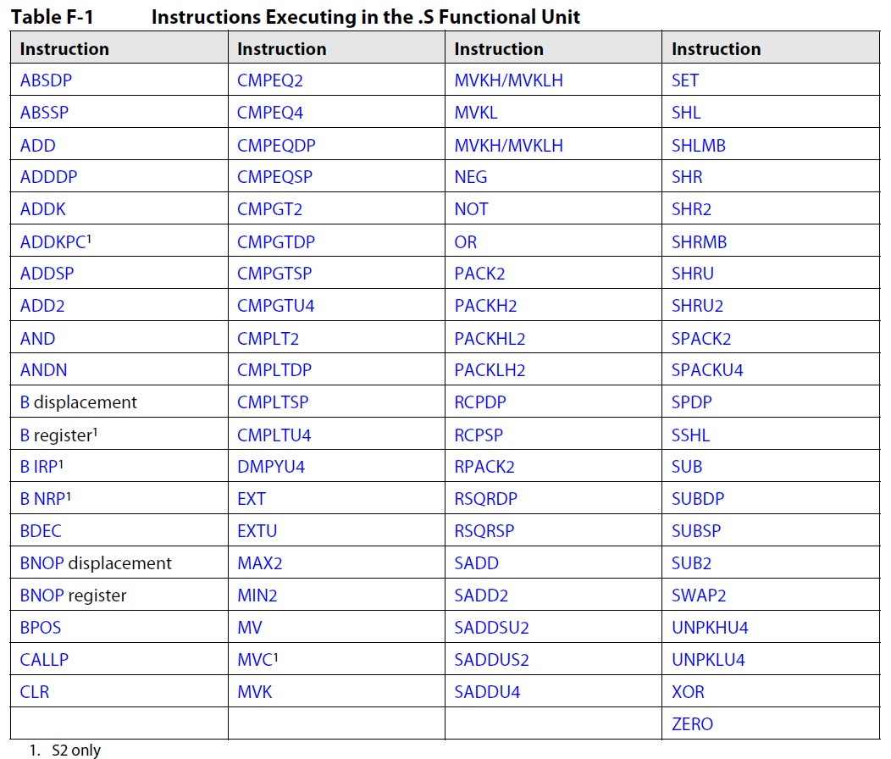
Partial List of .S Instructions

Slide 12
C66x CorePac Improvements Over C64x+
Wider internal bus
64 bit for the .L and .S functional units
128 bit for the .M functional unit
Wider cross path
64 bit for each direction
4x number of multipliers
More SIMD instructions
Enhanced instruction set
More than 100 new instructions added (compared to c64+)

Slide 13
Enhanced C66x Instruction Set
New SIMD instructions:
QMPY32 – 4-way SIMD of MYP32
DDOTP4H – 2-way SIMD of DOTP4H
DPACKL2 – SIMD version of PACKL2
DAVGU4 – Average of 8 packed unsigned bytes
New floating-point instructions:
MPYDP – Double Precision Multiplication
FMPYDP – Fast Double Precision multiplication
DINTSP – 2-Way SIMD Convert 32-bits Unsigned Integer to Single Precision Floating Point

Slide 14
Interesting New C66x Instructions
MFENCE (Memory Fence) Stall instruction pipeline until memory system is done.
RCPSP (Single-Precision Floating-Point Reciprocal Approximation)
RSQRSP (Single-Precision Floating-Point Square-Root Reciprocal Approximation)

Slide 15
C66x SIMD Instructions: Examples
ADDDP – Add Two Double-Precision Floating-Point Values
DADD2 – 4-Way SIMD Addition, Packed Signed 16-bit
Performs 4 additions of two sets of 4 16-bit numbers packed into 64-bit registers.
The 4 results are rounded to 4 packed 16-bit values
unit = .L1, .L2, .S1, .S2
FMPYDP - Fast Double-Precision Floating Point Multiply
QMPY32 - 4-Way SIMD Multiply, Packed Signed 32-bit.
Performs 4 multiplications of two sets of 4 32-bit numbers packed into 128-bit registers.
The 4 results are packed 32-bit values.
unit = .M1 or .M2

Slide 16
C66x SIMD Instruction: CMATMPY
Many applications use complex matrix arithmetic.
CMATMPY – 2x1 Complex Vector Multiply 2x2 Complex Matrix
Results in 1x2 signed complex vector.
All values are 16-bit (16-bit real/16-bit Imaginary)
unit = .M1 or .M2
How many multiplications are complex multiplication, where each complex multiplication has the following?
4 complex multiplications (4 real multiplications each)
Two M units (16 multiplications each) = 32 multiplications
Core cycles per second (1.25 G)
Total multiplications per second = 40 G multiplications
8 cores = 320 G multiplications
The issue here is, can we feed the functional units data fast enough?

Slide 17
Feeding the Functional Units
There are two challenges:
How to provide enough data from memory to the core
Access to L1 memory is wide (2 x 64 bit) and fast (0 wait state)
Multiple mechanisms are used to efficiently transfer new data to L1 from L2 and external memory.
How to get values in and out of the functional units
Hardware pipeline enables execution of instructions every cycle.
Software pipeline enables efficient instruction scheduling to maximize functional unit throughput.

Slide 18
Internal Buses
Program Address x32
PC
L1
Memories
Program Data x256
Fetch
Data Address - T1 x32
A
Regs
Data Data - T1 x32/64
L2 and
External
Memory
Data Address - T2 x32
B
Regs
Data Data - T2 x32/64
Peripherals
C62x: Dual 32-Bit Load/Store
C67x: Dual 64-Bit Load / 32-Bit Store
C64x, C674x, C66x: Dual 64-Bit Load/Store

Slide 19
Memory Subsystem
Memory Subsystem
Application-Specific
CorePac
64-Bit
MSM
Coprocessors
Memory Subsystem
DDR3 EMIF
SRAM
MSMC
Multicore Shared Memory (MSM SRAM)
2 to 4 MB
Available to all cores
Can contain program and data
Multicore Shared Memory Controller (MSMC)
Arbitrates access of CorePac and SoC masters to shared memory
Provides a connection to the DDR3 EMIF
Provides CorePac access to coprocessors and IO peripherals
Provides error detection and correction for all shared memory
Memory protection and address extension to 64 GB (36 bits)
Provides multi-stream pre-fetching capability
DDR3 External Memory Interface (EMIF)
Support for 16-bit, 32-bit, and 64-bit modes
Specified at up to 1600 MT/s
Supports power down of unused pins when using 16-bit or 32-bit width
Support for 8 GB memory address
Error detection and correction
Debug & Trace
Boot ROM
Semaphore
C66x™
Power
CorePac
Management
PLL
L1P
L1D
x3
Cache/RAM
Cache/RAM
EDMA
L2 Memory Cache/RAM
x3
1 to 8 Cores @ up to 1.25 GHz
HyperLink
TeraNet
Multicore Navigator
Queue
Packet
Manager
DMA
x2
x4
t
T
e
h
C
R
I
n
c
e
P
Application
Specific I/O
O
r
t
h
Security
Application
Specific I/O
GPIO
2
I
A
S
e
i
c
I
C
U
I
h
w
t
Accelerator
P
R
t
S
i
S
E
w
S
Packet
I
Accelerator
I
M
x2
G
S
Network Coprocessor
Notes:
19
NEW

Slide 20
Multicore Navigator
Memory Subsystem
Application-Specific
CorePac
64-Bit
MSM
Coprocessors
Memory Subsystem
DDR3 EMIF
SRAM
MSMC
Multicore Navigator
Debug & Trace
Provides seamless inter-core communications (messages and data exchanges) between cores, IP, and peripherals … “Fire and forget”
Low-overhead processing and routing of packet traffic to and from peripherals and cores
Supports dynamic load optimization
Data transfer architecture designed to minimize host interaction while maximizing memory and bus efficiency
Consists of a Queue Manager Subsystem (QMSS) and multiple, dedicated Packet DMA engines
Boot ROM
Semaphore
C66x™
Power
CorePac
Management
PLL
L1P
L1D
x3
Cache/RAM
Cache/RAM
EDMA
L2 Memory Cache/RAM
x3
1 to 8 Cores @ up to 1.25 GHz
HyperLink
TeraNet
Multicore Navigator
Queue
Packet
Manager
DMA
x2
x4
t
T
e
h
C
R
I
n
c
e
P
Application
Specific I/O
O
r
t
h
Security
Application
Specific I/O
GPIO
2
I
A
S
e
i
c
I
C
U
I
h
w
t
Accelerator
P
R
t
S
i
S
E
w
S
Packet
I
Accelerator
I
M
x2
G
S
Network Coprocessor
Notes:
20
NEW

Slide 21
Network Coprocessor
Memory Subsystem
Application-Specific
CorePac
64-Bit
MSM
Coprocessors
Memory Subsystem
DDR3 EMIF
SRAM
MSMC
Multicore Navigator
Debug & Trace
Network Coprocessor
Boot ROM
Provides hardware accelerators to perform L2, L3, and L4 processing and encryption that was previously done in software
Packet Accelerator (PA)
8K multiple-in, multiple-out HW queues
Single IP address option
UDP (and TCP) checksum and selected CRCs
L2/L3/L4 support
Quality of Service (QoS)
Multicast to multiple queues
Timestamps
Security Accelerator (SA)
Hardware encryption, decryption, and authentication
Supports IPsec ESP, IPsec AH, SRTP, and 3GPP protocols
Semaphore
C66x™
Power
CorePac
Management
PLL
L1P
L1D
x3
Cache/RAM
Cache/RAM
EDMA
L2 Memory Cache/RAM
x3
1 to 8 Cores @ up to 1.25 GHz
HyperLink
TeraNet
Multicore Navigator
Queue
Packet
Manager
DMA
x2
x4
t
T
e
h
C
R
I
n
c
e
P
Application
Specific I/O
O
r
t
h
Security
Application
Specific I/O
GPIO
2
I
A
S
e
i
c
I
C
U
I
h
w
t
Accelerator
P
R
t
S
i
S
E
w
S
Packet
I
Accelerator
I
M
x2
G
S
Network Coprocessor
Notes:
21
NEW

Slide 22
External Interfaces
Memory Subsystem
Application-Specific
CorePac
64-Bit
MSM
Coprocessors
Memory Subsystem
DDR3 EMIF
SRAM
MSMC
Multicore Navigator
Debug & Trace
Network Coprocessor
Boot ROM
External Interfaces
Semaphore
C66x™
2x SGMII ports support 10/100/1000 Ethernet
4x high-bandwidth Serial RapidIO (SRIO) lanes for inter-DSP applications
SPI for boot operations
UART for development/testing
2x PCIe at 5 Gbps
I2C for EPROM at 400 Kbps
16x GPIO pins
Application-specific interfaces
Power
CorePac
Management
PLL
L1P
L1D
x3
Cache/RAM
Cache/RAM
EDMA
L2 Memory Cache/RAM
x3
1 to 8 Cores @ up to 1.25 GHz
HyperLink
TeraNet
Multicore Navigator
Queue
Packet
Manager
DMA
x2
x4
t
T
e
h
C
R
I
n
c
e
P
Application
Specific I/O
O
r
t
h
Security
Application
Specific I/O
GPIO
2
I
A
S
e
i
c
I
C
U
I
h
w
t
Accelerator
P
R
t
S
i
S
E
w
S
Packet
I
Accelerator
I
M
x2
G
S
Network Coprocessor
Notes:
22
NEW

Slide 23
TeraNet Switch Fabric
Memory Subsystem
Application-Specific
CorePac
64-Bit
MSM
Coprocessors
Memory Subsystem
DDR3 EMIF
SRAM
MSMC
Multicore Navigator
Debug & Trace
Network Coprocessor
Boot ROM
External Interfaces
Semaphore
C66x™
TeraNet Switch Fabric
Power
CorePac
A non-blocking switch fabric that enables fast and contention-free internal data movement
Provides a configured way – within hardware – to manage traffic queues and ensure priority jobs are getting accomplished while minimizing the involvement of the CorePac cores
Facilitates high-bandwidth communications between CorePac cores, subsystems, peripherals, and memory
Management
PLL
L1P
L1D
x3
Cache/RAM
Cache/RAM
EDMA
L2 Memory Cache/RAM
x3
1 to 8 Cores @ up to 1.25 GHz
HyperLink
TeraNet
Multicore Navigator
Queue
Packet
Manager
DMA
x2
x4
t
T
e
h
C
R
I
n
c
e
P
Application
Specific I/O
O
r
t
h
Security
Application
Specific I/O
GPIO
2
I
A
S
e
i
c
I
C
U
I
h
w
t
Accelerator
P
R
t
S
i
S
E
w
S
Packet
I
Accelerator
I
M
x2
G
S
Network Coprocessor
Notes:
23
NEW

Slide 24
Diagnostic Enhancements
Memory Subsystem
Application-Specific
CorePac
64-Bit
MSM
Coprocessors
Memory Subsystem
DDR3 EMIF
SRAM
MSMC
Multicore Navigator
Debug & Trace
Network Coprocessor
Boot ROM
External Interfaces
Semaphore
C66x™
TeraNet Switch Fabric
Power
CorePac
Diagnostic Enhancements
Management
PLL
L1P
L1D
Embedded Trace Buffers (ETB) enhance the diagnostic capabilities of the CorePac.
CP Monitor enables diagnostic capabilities on data traffic through the TeraNet switch fabric.
Automatic statistics collection and exporting (non-intrusive)
Monitors individual events for better debugging
Monitors transactions to both memory end point and Memory-Mapped Registers (MMR)
Configurable monitor-filtering capability based on address and transaction type
x3
Cache/RAM
Cache/RAM
EDMA
L2 Memory Cache/RAM
x3
1 to 8 Cores @ up to 1.25 GHz
HyperLink
TeraNet
Multicore Navigator
Queue
Packet
Manager
DMA
x2
x4
t
T
e
h
C
R
I
n
c
e
P
Application
Specific I/O
O
r
t
h
Security
Application
Specific I/O
GPIO
2
I
A
S
e
i
c
I
C
U
I
h
w
t
Accelerator
P
R
t
S
i
S
E
w
S
Packet
I
Accelerator
I
M
x2
G
S
Network Coprocessor
Notes:
24
NEW

Slide 25
HyperLink Bus
Memory Subsystem
Application-Specific
CorePac
64-Bit
MSM
Coprocessors
Memory Subsystem
DDR3 EMIF
SRAM
MSMC
Multicore Navigator
Debug & Trace
Network Coprocessor
Boot ROM
External Interfaces
Semaphore
C66x™
TeraNet Switch Fabric
Power
CorePac
Diagnostic Enhancements
Management
PLL
L1P
L1D
HyperLink Bus
x3
Cache/RAM
Cache/RAM
EDMA
L2 Memory Cache/RAM
Provides the capability to expand the device to include hardware acceleration or other auxiliary processors
Supports four lanes with up to 12.5 Gbaud per lane
x3
1 to 8 Cores @ up to 1.25 GHz
HyperLink
TeraNet
Multicore Navigator
Queue
Packet
Manager
DMA
x2
x4
t
T
e
h
C
R
I
n
c
e
P
Application
Specific I/O
O
r
t
h
Security
Application
Specific I/O
GPIO
2
I
A
S
e
i
c
I
C
U
I
h
w
t
Accelerator
P
R
t
S
i
S
E
w
S
Packet
I
Accelerator
I
M
x2
G
S
Network Coprocessor
Notes:
25
NEW

Slide 26
Miscellaneous Elements
Memory Subsystem
Application-Specific
CorePac
64-Bit
MSM
Coprocessors
Memory Subsystem
DDR3 EMIF
SRAM
MSMC
Multicore Navigator
Debug & Trace
Network Coprocessor
Boot ROM
External Interfaces
Semaphore
C66x™
TeraNet Switch Fabric
Power
CorePac
Diagnostic Enhancements
Management
PLL
L1P
L1D
HyperLink Bus
x3
Cache/RAM
Cache/RAM
Miscellaneous
EDMA
L2 Memory Cache/RAM
x3
1 to 8 Cores @ up to 1.25 GHz
Boot ROM
Semaphore module provides atomic access to shared chip-level resources.
Power management
Three on-chip PLLs:
PLL1 for CorePacs (and all modules except DDR3 and PA)
PLL2 for DDR3
PLL3 for Packet Acceleration
Three EDMA controllers
Eight 64-bit timers
Inter-Processor Communication (IPC) registers
HyperLink
TeraNet
Multicore Navigator
Queue
Packet
Manager
DMA
x2
x4
t
T
e
h
C
R
I
n
c
e
P
Application
Specific I/O
O
r
t
h
Security
Application
Specific I/O
GPIO
2
I
A
S
e
i
c
I
C
U
I
h
w
t
Accelerator
P
R
t
S
i
S
E
w
S
Packet
I
Accelerator
I
M
x2
G
S
Network Coprocessor
Notes:
26
NEW

Slide 27
App-Specific: Wireless Applications
Memory Subsystem
C6670
Coprocessors
CorePac
64-Bit
2MB
Memory Subsystem
DDR3 EMIF
MSM
SRAM
MSMC
Multicore Navigator
Debug & Trace
RSA
RSA
Network Coprocessor
x2
VCP2
x4
External Interfaces
Boot ROM
Semaphore
C66x™
TCP3d
x2
TeraNet Switch Fabric
Power
CorePac
Diagnostic Enhancements
Management
TCP3e
PLL
32KB L1P
32KB L1D
HyperLink Bus
x3
Cache/RAM
Cache/RAM
FFTC
x2
Miscellaneous
EDMA
1024KB L2 Cache/RAM
x3
4 Cores @ 1.0 GHz / 1.2 GHz
BCP
Application-Specific
HyperLink
TeraNet
Wireless Applications
Multicore Navigator
Wireless-specific coprocessors:
2x FFT Coprocessor (FFTC)
Turbo Decoder/Encoder Coprocessor (TCP3D/3E)
4x Viterbi Coprocessor (VCP2)
Bit-rate Coprocessor (BCP)
2x Rake Search Accelerator (RSA)
Wireless-specific interface:
6x Antenna Interface 2 (AIF2)
Queue
Packet
Manager
DMA
x2
x6
x4
t
T
e
h
C
R
I
n
c
e
P
O
r
t
h
Security
GPIO
2
I
A
S
2
e
i
c
Accelerator
I
C
U
F
I
h
w
t
P
I
R
t
S
i
A
S
E
w
S
Packet
I
Accelerator
I
M
2
G
×
S
Network Coprocessor
Notes:
27
NEW

Slide 28
App-Specific: General Purpose
Memory Subsystem
C6671/C6672 C6674/C6678
CorePac
64-Bit
4MB
Memory Subsystem
DDR3 EMIF
MSM
SRAM
MSMC
Multicore Navigator
Debug & Trace
Network Coprocessor
Boot ROM
External Interfaces
Semaphore
C66x™
TeraNet Switch Fabric
Power
CorePac
Diagnostic Enhancements
Management
PLL
32KB L1P
32KB L1D
HyperLink Bus
x3
Cache/RAM
Cache/RAM
Miscellaneous
EDMA
512KB L2 Cache/RAM
x3
1 to 8 Cores @ up to 1.25 GHz
Application-Specific
HyperLink
TeraNet
General Purpose Applications
TeraNet
Multicore Navigator
General purpose application interfaces:
2x Telecommunications Serial Port (TSIP)
EMIF 16 (EMIF-A) :
Connects memory up to 256 MB
Three modes:
Synchronized SRAM
NAND flash
NOR flash
Queue
Packet
Manager
DMA
6
x2
x2
x4
t
1
O
T
e
h
C
R
I
n
c
F
I
e
P
P
O
r
t
h
Security
I
P
2
I
A
S
e
i
c
Accelerator
M
G
I
C
U
I
I
h
w
t
E
P
S
R
t
S
i
T
S
E
w
S
Packet
I
Accelerator
I
M
x2
G
S
Network Coprocessor
Notes:
28
NEW

Slide 29
Low-Power Low-Cost KeyStone C665x Sub-family

Slide 30
KeyStone C6655/57: Device Features
C66x CorePac
C6655: One C66x CorePac DSP Core at 1.0 or 1.25 GHz
C6657: Two C66x CorePac DSP Cores at 0.85, 1.0, or 1.25 GHz
Fixed and Floating Point Operations
Backward-compatible with C64x+ and C67x+ cores
Memory Subsystem
1 MB Local L2 memory per core
Multicore Shared Memory Controller (MSMC)
32-bit DDR3 Interface
Hardware Coprocessors
Turbo Coprocessor Decoder (TCP3d)
2x Viterbi Coprocessors (VCP2)
Multicore Navigator
Queue Manager (8192 hardware queues)
Packet-based DMA
Interfaces
High-speed Hyperlink bus
One 10/100/1000 Ethernet SGMII port
4x Serial RapidIO (SRIO) Rev 2.1
2x PCIe Gen2
2x Multichannel Buffered Serial Ports (McBSP)
One Asynchronous Memory Interface (EMIF16)
Additional Serials: SPI, I²C, UPP, GPIO, UART
Embedded Trace Buffer (ETB) and System Trace Buffer (STB)
Smart Reflex Enabled
40 nm High-Performance Process
Memory Subsystem
1MB
C6655/57
32-Bit
MSM
DDR3 EMIF
SRAM
MSMC
Debug & Trace
Boot ROM
2nd core, C6657 only
Semaphore
Timers
C66x™
Security /
CorePac
Key Manager
Coprocessors
Power
Management
32KB L1
32KB L1
TCP3d
PLL
P-Cache
D-Cache
x2
1024KB L2 Cache
VCP2
x2
EDMA
1 or 2 Cores @ up to 1.25 GHz
HyperLink
TeraNet
Multicore Navigator
Queue
Packet
Manager
DMA
6
x2
x2
x2
x4
1
O
P
T
I
P
Ethernet
F
I
P
S
O
MAC
I
P
I²C
R
P
e
I
M
G
U
A
S
B
I
E
U
c
C
R
M
P
S
SGMII
Notes:
30
NEW

Slide 31
KeyStone C6654: Power Optimized
C66x CorePac
C6654: One CorePac DSP Core at 850 MHz
Fixed and Floating Point Operations
Backward compatible with C64x+ and C67x+ cores
Memory Subsystem
1 MB Local L2 memory
Multicore Shared Memory Controller (MSMC)
32-bit DDR3 Interface
Multicore Navigator
Queue Manager (8192 hardware queues)
Packet-based DMA
Interfaces
One 10/100/1000 Ethernet SGMII port
2x PCIe Gen2
2x Multichannel Buffered Serial Ports (McBSP)
One Asynchronous Memory Interface (EMIF16)
Additional Serials: SPI, I²C, UPP, GPIO, UART
Embedded Trace Buffer (ETB) and System Trace Buffer (STB)
Smart Reflex Enabled
40 nm High-Performance Process
Memory Subsystem
C6654
32-Bit
MSMC
DDR3 EMIF
Debug & Trace
Boot ROM
Semaphore
Timers
C66x™
Security /
CorePac
Key Manager
Power
Management
32KB L1
32KB L1
PLL
P-Cache
D-Cache
x2
1024KB L2 Cache
EDMA
1 Core @ 850 MHz
TeraNet
Multicore Navigator
Queue
Packet
Manager
DMA
6
x2
x2
x2
1
O
P
T
I
P
Ethernet
F
I
P
S
MAC
I
P
I²C
R
P
e
M
G
U
A
S
B
I
E
U
c
C
M
P
SGMII
Notes:
31
NEW

Slide 32
KeyStone C665x: Key HW Variations
HW Feature | C6654 | C6655 |  | C6657
CorePac Frequency (GHz) | 0.85 | 1 @ 1.0, 1.25 | 2 @ 0.85, 1.0, 1.25
Multicore Shared Memory (MSM) | No | 1024KB SRAM
DDR3 Maximum Data Rate | 1066 | 1333
Serial Rapid I/O Lanes | No | 4x
HyperLink | No | Yes
Viterbi Coprocessor (VCP) | No | 2x
Turbo Coprocessor Decoder (TCP3d) | No | Yes

Slide 33
For More Information
For more information, refer to the C66x Getting Started page to locate the data manual for your KeyStone device.
View the complete C66x Multicore SOC Online Training for KeyStone Devices, including details on the individual modules.
For questions regarding topics covered in this training, visit the support forums at the TI E2E Community website.
Notes:
NEW

Slide 34
Additional Information
Notes:
NEW

Slide 35
Memory Subsystem – Additional Information
Memory subsystem provides:
Address extension/translation
Memory protection for addresses outside C66x
Shared memory access path
Cache and pre-fetch support
Two Register Sets:
MPAX registers – Memory Protection and Extension Registers (16)
MAR registers – Memory Attributes registers (256)
Each CorePac has its own set of MPAX and MAR registers!

Slide 36
Multicore Navigator - Additional Information

Slide 37
Network Coprocessor (Logical) Additional Information
PKTDMA Queue
Lookup Engine
(IPSEC16 entries, 32 IP, 16 Ethernet)
QMSS FIFO Queue
Packet Accelerator
SRIO message RX
Classify
Pass 1
CorePac 0
Classify
Pass 2
DSP 0
DSP 0
Ethernet
RX MAC
RX PKTDMA
DSP 0
Security Accelerator
(cp_ace)
Ingress Path
Egress Path
Ethernet TX MAC
Modify
Modify
Ethernet TX MAC
TX PKTDMA
SRIO message TX
Notes:
REUSABLE – nothing here needs to be rerecorded

Slide 38
External Interfaces - Additional Information
Common Interfaces
One PCI Express (PCIe) Gen II port
Two lanes running at 5G Baud
Support for root complex (host) mode and end point mode
Single Virtual Channel (VC) and up to eight Traffic Classes (TC)
Hot plug
Universal Asynchronous Receiver/Transmitter (UART)
2.4, 4.8, 9.6, 19.2, 38.4, 56, and 128 K baud rate
Serial Port Interface (SPI)
Operate at up to 66 MHz
Two-chip select
Master mode
Inter IC Control Module (I²C)
One for connecting EPROM (up to 4Mbit)
400 Kbps throughput
Full 7-bit address field
General Purpose IO (GPIO) module
16-bit operation
Can be configured as interrupt pin
Interrupt can select either rising edge or falling edge
Serial RapidIO (SRIO)
RapidIO 2.1 compliant
Four lanes @ 5 Gbps
1.25/2.5/3.125/5 Gbps operation per lane
Configurable as four 1x, two 2x, or one 4x
Direct I/O and message passing (VBUSM slave)
Packet forwarding
Improved support for dual-ring daisy-chain
Reset isolation
Upgrades for inter-operation with packet accelerator
Two SGMII ports with embedded switch
Supports IEEE1588 timing over Ethernet
Supports 1G/100 Mbps full duplex
Supports 10/100 Mbps half duplex
Inter-working with RapidIO message
Integrated with packet accelerator for efficient IPv6 support
Supports jumbo packets (9 Kb)
Three-port embedded Ethernet switch with packet forwarding
Reset isolation with SGMII ports and embedded ETH switch
Application-Specific Interfaces
For Wireless Applications
Antenna Interface 2 (AIF2)
Multiple-standard support (WCDMA, LTE, WiMAX, GSM/Edge)
Generic packet interface (~12Gbits/sec ingress & egress)
Frame Sync module (adapted for WiMAX, LTE & GSM slots/frames/symbols boundaries)
Reset Isolation
For Media Gateway Applications
Telecommunications Serial Port (TSIP)
Two TSIP ports for interfacing TDM applications
Supports 2/4/8 lanes at 32.768/16.384/8.192 Mbps per lane & up to 1024 DS0s
EMIF 16 (256MB)
NAND
NOR
Synchronized SRAM
Notes:
38
MOSTLY REUSABLE (PCIe, UART, SPI, I2C, GPIO, SRIO, SGMII) – Need new audio for HyperLink and Application-specific I/O >> AIF2 and TSIP

Slide 39
Serial RapidIO - Additional Information
SRIO or RapidIO provides a 3-layered architecture
Physical defines electrical characteristics, link flow control (CRC)
Transport defines addressing scheme (8b/16b device IDs)
Logical defines packet format and operational protocol
Two basic modes of logical layer operation
DirectIO
Transmit device needs knowledge of memory map of receiving device
Includes NREAD, NWRITE_R, NWRITE, SWRITE
Functional units: LSU, MAU, AMU
Message Passing
Transmit Device does not need knowledge of memory map of receiving device
Includes Type 11 messages and Type 9 packets
Functional units: TXU, RXU
Gen 2 Implementation – Supporting up to 5 Gbps

Slide 40
TeraNet - Additional Information
HyperLink
S
MSMC
DDR3
S
M
CPUCLK/2
256bit TeraNet
Shared L2
S
HyperLink
DDR3
M
S
S
S
S
M
TPCC
16ch QDMA
TC0
M
EDMA_0
TC1
M
Facilitates high-bandwidth communication links between DSP cores, subsystems, peripherals, and memories.
Supports parallel orthogonal communication links
XMC
S
L2 0-3
M
SRIO
S
Core
M
M
S
Core
M
M
S
Core
M
Network
Coprocessor
M
SRIO
TPCC
64ch
QDMA
TC2
M
S
TC3
M
S
TPCC
64ch
QDMA
TC6
M
TCP3e_W/R
TC4
M
TC5
TC7
M
M
TC8
M
TC9
M
S
EDMA_1,2
TCP3d
S
CPUCLK/3
128bit TeraNet
TCP3d
TAC_BE
TAC_FE
S
M
RAC_FE
RAC_BE0,1
S
M
RAC_FE
RAC_BE0,1
S
M
FFTC / PktDMA
M
FFTC / PktDMA
M
VCP2 (x4)
S
VCP2 (x4)
S
VCP2 (x4)
AIF / PktDMA
S
M
VCP2 (x4)
S
QMSS
M
QMSS
PCIe
S
M
S
PCIe
DebugSS
M
Notes:
CPT see physical addresses. In MSMC, one CPT per bank.

Slide 41
Debug – Additional Information
Multicore emulation support, host tooling, can halt any or all of the cores on the device.
Each core supports a direct connection to the JTAG interface.
Emulation has full visibility of the CorePac memory map.
Adds third mode of running, halt, in response to “critical” interrupts
Supports core and system trace into different trace buffers (4K, 32K) or external receiver(up to 2G on XDS560v2 Pro)
Ability to dynamically drain trace buffers from the application
Advanced Event Triggering (AET) allows the user to identify and trigger on events of interest from the code or the debugger.
Common Platform Trace (CP Tracer) provides statistical gathering into trace buffer for various slave interfaces. Enables profiling, identification of bottlenecks, and instrumentation.
Notes:
41
NEW -- Not much at all was said about emulation features in the original presentation. I’ve broken it into two slides to make it more readable. Can you record new audio here and briefly touch on what is on each slide?

Slide 42
Miscellaneous Elements –Additional Information
Support to assert NMI (Non-maskable Interrupt) input for each core; Separate hardware pins for NMI and core selector.
Support for local reset for each core; Separate hardware pins for local reset and core selector.

Slide 43
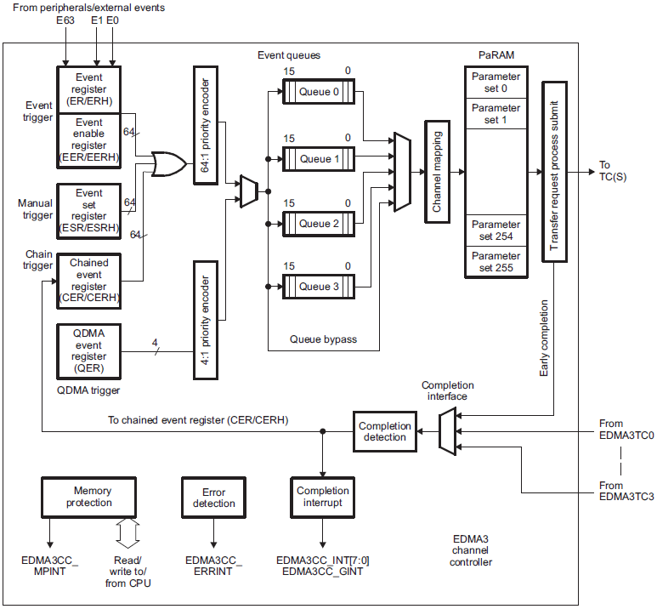
EDMA – Additional Information
Three EDMA Channel Controllers:
One controller in CPU/2 domain:
Two transfer controllers/queues with 1KB channel buffer
Eight QDMA channels
16 interrupt channels
128 PaRAM entries
Two controllers in CPU/3 domain: Each includes the following:
Four transfer controllers/queues with 1KB or 512B channel buffer
Eight QDMA channels
64 interrupt channels
512 PaRAM entries
Interrupt generation
Transfer completion
Error conditions
510
511

Slide 44
FFT Coprocessor (FFTC) - Additional Information
The FFTC has been designed to be compatible with various OFDM-based wireless standards like WiMax and LTE up to 8192 16-bit I/Q.
Packet DMA (PKTDMA) is used to move data in and out of the FFTC module.
The FFTC supports four input (Tx) queues that are serviced in a round-robin fashion.
LTE 7.5 kHz frequency shift
Dynamic and programmable scaling modes
Dynamic scaling mode returns block exponent
Support for left-right FFT shift (switch the left/right halves)
Support for variable FFT shift
For OFDM (Orthogonal Frequency Division Multiplexing) downlink, supports data format with DC subcarrier in the middle of the subcarriers
Support for cyclic prefix
Addition and removal
Any length supported

Slide 45
Turbo CoProcessor 3 Decoder (TCP3D) Additional Information
Programmable peripheral for decoding of 3GPP (WCDMA, HSUPA, HSUPA+, TD_SCDMA), LTE, and WiMax turbo codes.
LTE Bit Processing
Per Transport Block
Per Code Block
Soft Bits
De-Scrambling
Channel
De-interleaver
LLR
combining
De-Rate
Matching
LLR Data
Systematic
Parity 0
Parity 1
TB CRC
Hard decision
TCP3D
Decoded bits
Notes:
TCP turbo coprocessor
TCP3D is a programmable peripheral for decoding of 3GPP (WCDMA, HSUPA, HSUPA+, TD_SCDMA), LTE and WiMax turbo codes.
Turbo decoding is a part of bit processing which are very similar in CDMA and OFMD systems. TCP3D is used in LTE system, the inputs into the TCP3D are LLR data for systematic and parity bits coming form rate de-matching, the outputs of TCP are hard decision, also called decoded bits.
TCP3 calculate decoded code block’s CRC, in case of TB with one CB, CRC result generated by TCP3 is TB CRC, so in this case TB CRC do not need to perfermed by CPU anymore.
Only in TB with multiple CBs case, the TB CRC need to calculate by CPU when all CBs are avalible.

Slide 46

Turbo CoProcessor 3 Encoder (TCP3E) – Additional Information
TCP3E = Turbo CoProcessor 3 Encoder
3GPP, WiMAX and LTE encoding
3GPP includes: WCDMA, HSDPA, and TD-SCDMA
No previous versions, but came out at same time as third version of decoder co-processor (TCP3D)
Performs Turbo Encoding for forward error correction of transmitted information (downlink for basestation), adds redundant data to transmitted message
Downlink
Turbo Encoder
(TCP3E)
Turbo Decoder
in Handset

Slide 47
Bit Rate Coprocessor (BCP) – Additional Information
The Bit Rate Coprocessor (BCP) is a programmable peripheral for baseband bit processing.
Integrated into the TI DSP, the BCP supports FDD LTE, TDD LTE, WCDMA, TD-SCDMA, HSPA, HSPA+, WiMAX 802.16-2009 (802.16e), and monitoring/planning for LTE-A.
Primary functionalities of the BCP peripheral include the following:
CRC
Turbo / convolutional encoding
Rate Matching (hard and soft) / rate de-matching
LLR combining
Modulation (hard and soft)
Interleaving / de-interleaving
Scrambling / de-scrambling
Correlation (final de-spreading for WCDMA RX and PUCCH correlation)
Soft slicing (soft demodulation)
128-bit Navigator interface
Two 128-bit direct I/O interfaces
Runs in parallel with DSP
Internal debug logging
Notes:
47
NEW

Slide 48
Viterbi Decoder Coprocessor (VCP2) – Additional Information
Variable constraint length, K=5,6,7,8, or 9
User-supplied code coefficients
1/2 , 1/3 or 1/4 code rate
Configurable trace back settings (convergence distance, frame structure)
Branch metrics calculations and de-puncturing done in software by DSP
Communication to and from cores is done using EDMA3

